Slide 1
Software Engineering
CSE-3203

Slide 2
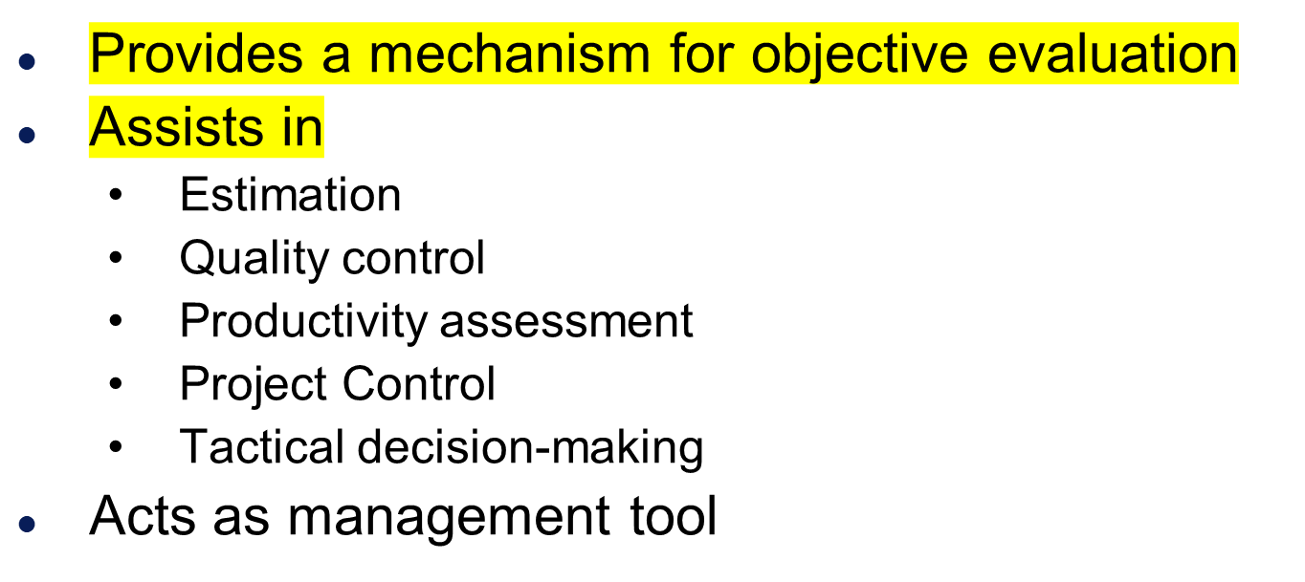
Measurement

Slide 3
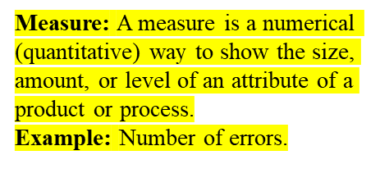
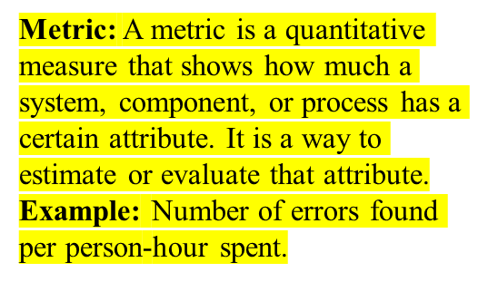
Definitions
Measure - quantitative indication of extent, amount, dimension, capacity, or size of some attribute of a product or process.
  E.g., Number of errors
Metric - quantitative measure of degree to which a system, component or process possesses a given attribute. “A handle or guess about a given attribute.”
  E.g., Number of errors found per person hours expended

Slide 4

Determine the quality of the current product or process
Predict qualities of a product/process
Improve quality of a product/process

Slide 5

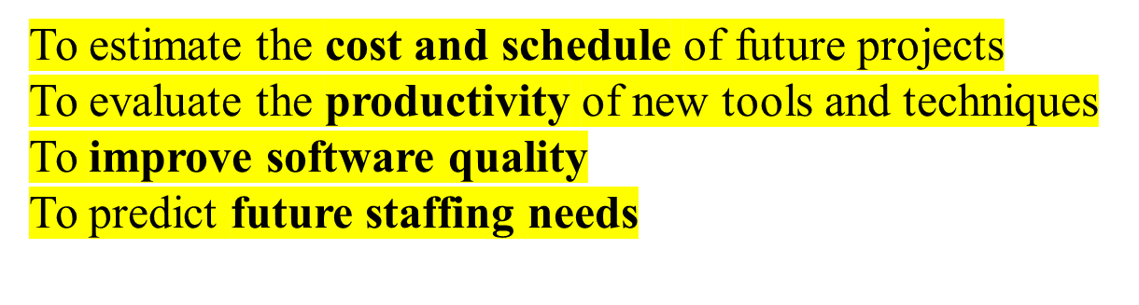
Estimate the cost & schedule of future projects
Evaluate the productivity impacts of new tools and techniques
Improve software quality
Forecast future staffing needs

Slide 6

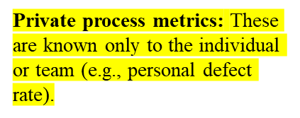
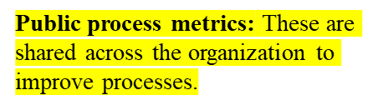
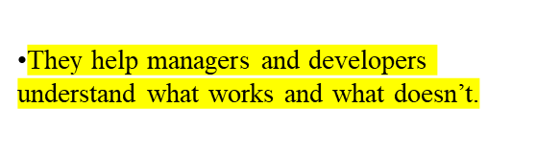

Private process metrics (e.g. defect rates by individual or module) are only known to by the individual or team concerned
Public process metrics enable organizations to make strategic changes to improve the software process.
Enable managers and practitioners to assess what works and what doesn't.
Process metrics are collected across all projects and over long periods of time.

Slide 7

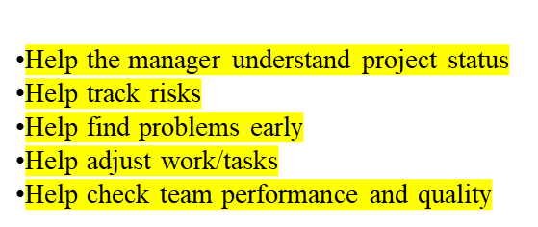
Enable a software project manager to
  assess the status of an ongoing project
  track potential risks
  uncover problem areas before they "go critical”
  adjust work flow or tasks
  evaluate the project team's ability to control quality of software engineering work products.

Slide 8
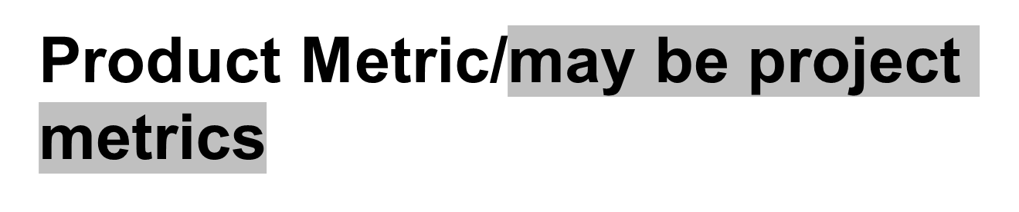
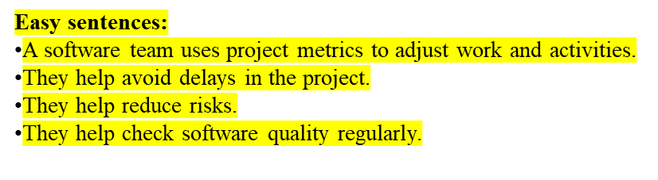
A software team can use software project metrics to adapt project workflow and technical activities.
Project metrics are used to avoid development schedule delays, to mitigate potential risks, and to assess product quality on an on-going basis.

Slide 9

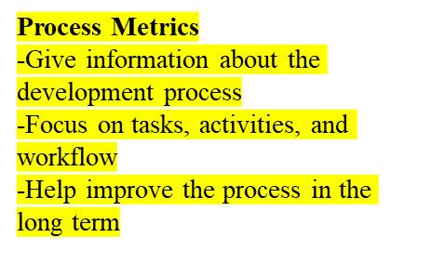
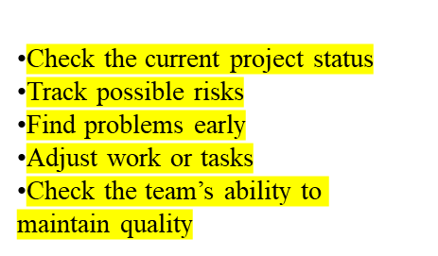
Process Metrics
  Insights of process paradigm, software engineering tasks, work product, or milestones
  Lead to long term process improvement
Product Metrics
  Assesses the state of the project
  Track potential risks
  Uncover problem areas
  Adjust workflow or tasks
  Evaluate teams ability to control quality

Slide 10

Direct Measures (internal attributes)
  Cost, effort, LOC, speed, memory
Indirect Measures (external attributes)
  Functionality, quality, complexity, efficiency, reliability, maintainability

Slide 11
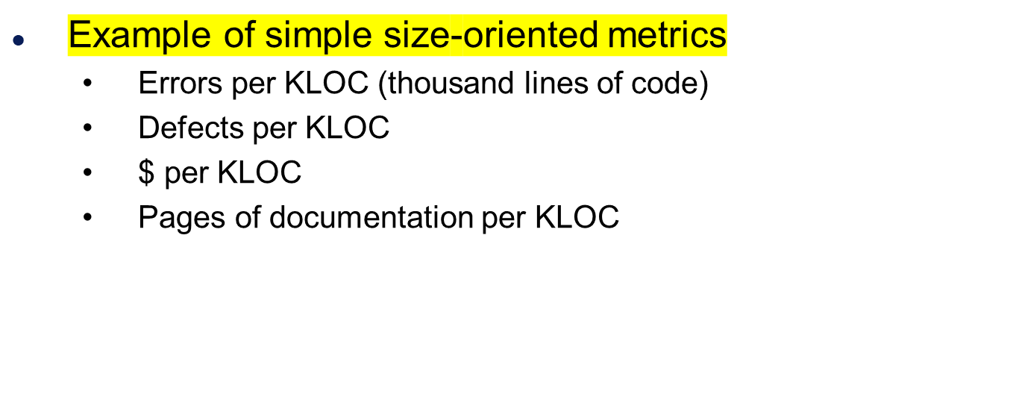
Size-Oriented Metrics

Slide 12
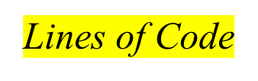
LOC Metrics
Easy to use
Easy to compute
Language & programmer dependent

Slide 13

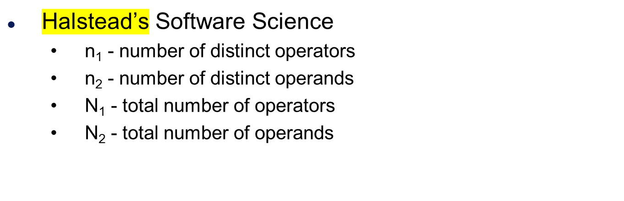
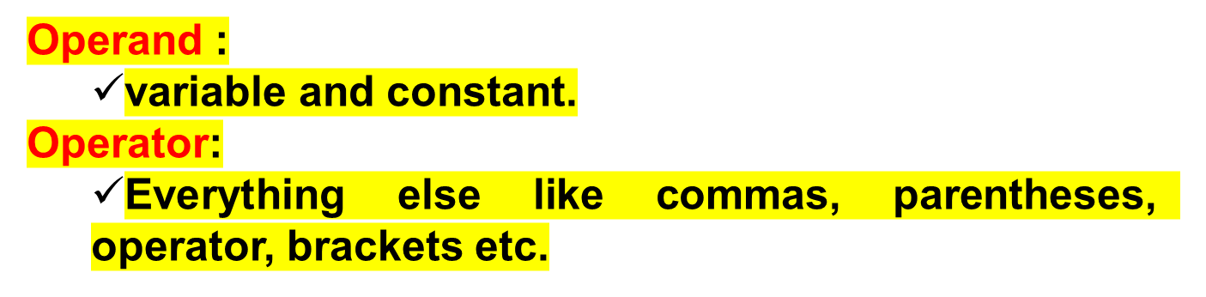

Slide 14
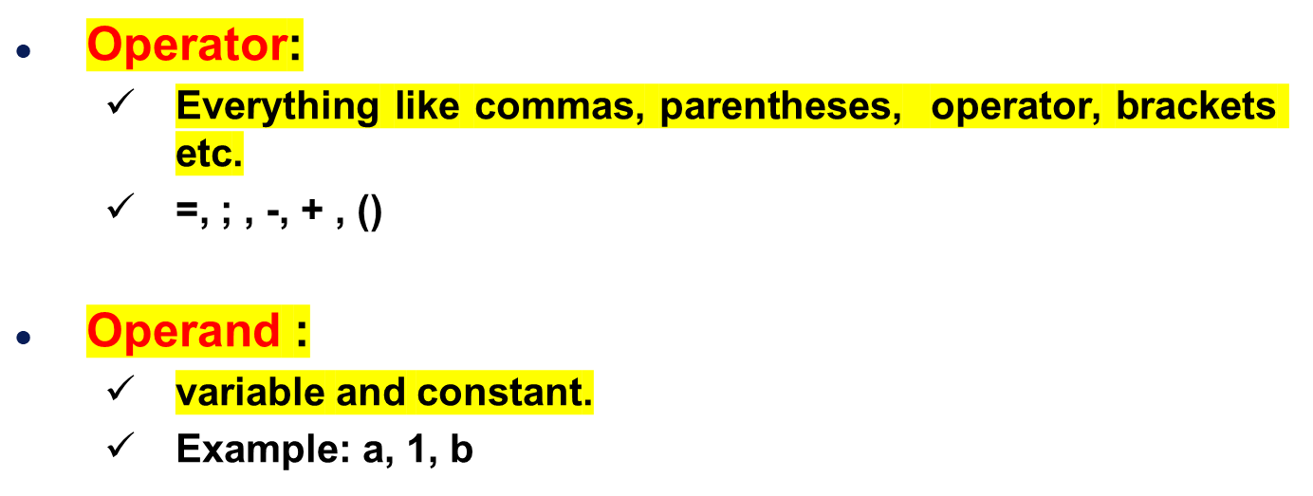
Definition

Slide 15




Example
Operator
Token | Count
If | 2
() | 2
< | 1
> | 1
= | 1
* | 1
; | 1
{} | 1
if (k < 2)
{
if (k > 3)
x = x*k;
}
Operand
Token | Count
k | 2
2 | 1
3 | 1
X | 2
n₁ - number of distinct operators =8
n₂ - number of distinct operands= 4
n=12

Slide 16
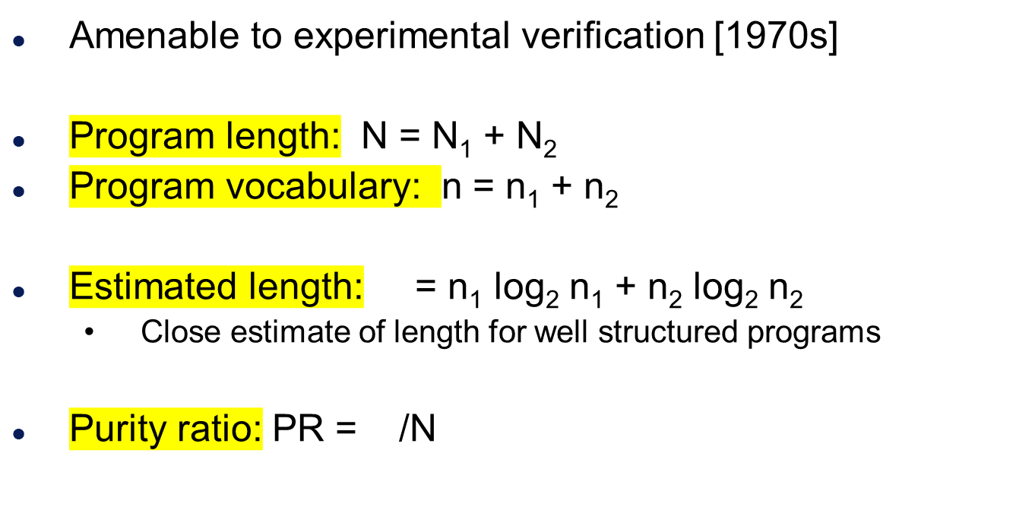

Halstead’s Metrics

Slide 17

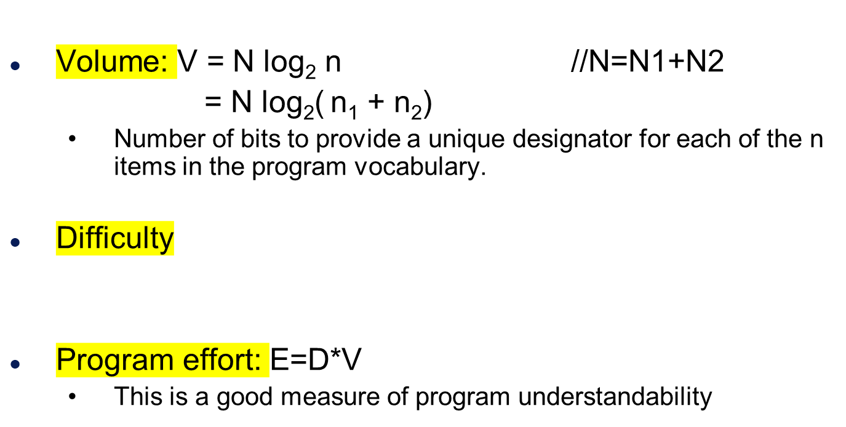


Slide 18




Program Complexity

Slide 19
END

